Slide 1
NEW FOLDER
Preliminary Design Review
Andrei Fusilli Brandon Brown Bach Nguyen Cody Guay Peter Lodato Zachary Weeden
3.22.2018

Slide 2
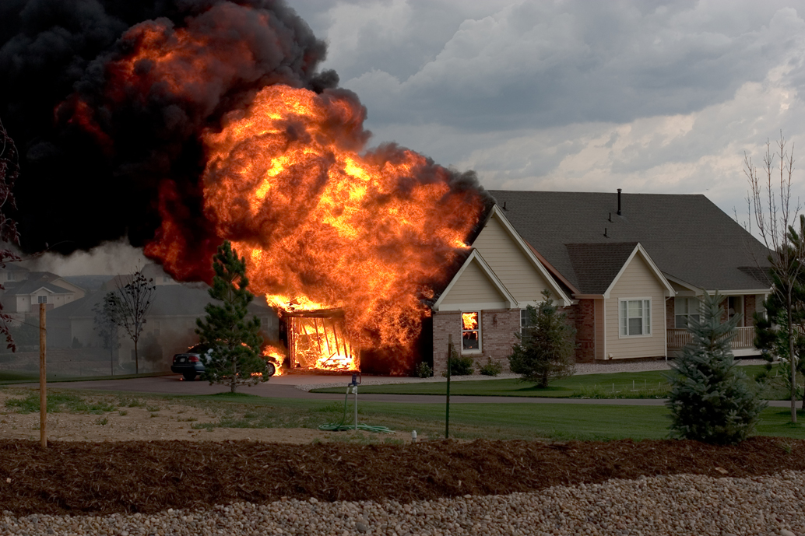
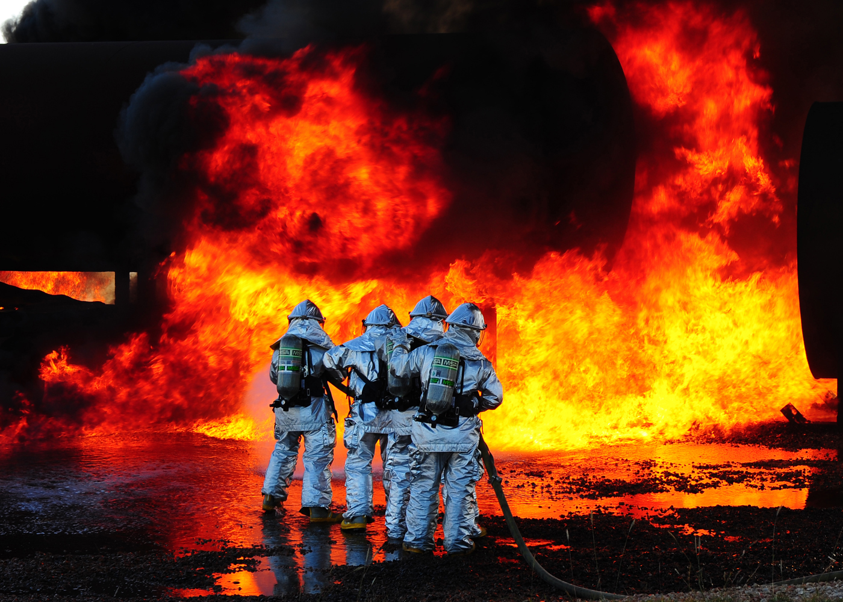
New Folder
Notes:
Ask audience, “Does anyone here know how many US firefighters have died in 2016 while on duty?”

Slide 3
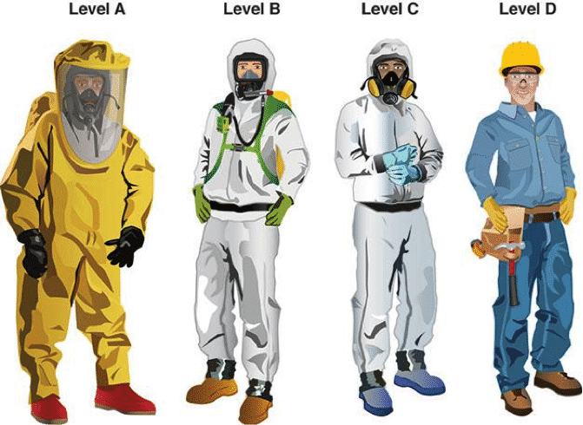
New Folder
Eighty-nine firefighters (56 volunteer, 23 career and 10 wildland agency) died while on duty in 2016. - USFA
Not every firefighter has the correct equipment when dealing with emergencies.

Slide 4
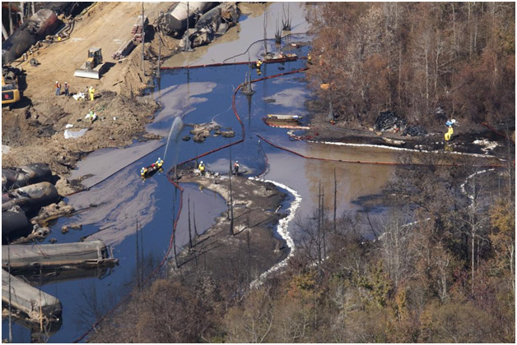
Our Mission
New Folder
To protect our loved ones from disastrous fire events and spills
Respond quickly and efficiently to deal with emergencies
Create a safer situation in dealing with HazMat (Hazardous Materials)

Slide 5
Our Mission - RECON ROVER!
New Folder
An semi-autonomous rover that would detect fire, humans, animals and toxic chemicals
Remote control capabilities
It will survey the surroundings so it’ll be let the fighters know any immediate dangers or humans endangered.
Real-Time Camera Feed
Ultrasonic Sensors
Gyro Sensors
Speak and Mic (Phase II)
Thermal Sensors (Phase II)
Air Pollution Sensors (Phase II)
Arm Attachments (Phase II)

Slide 6
New Folder
Team Members/Responsibilities
Andrei Fusilli – Product Management
Brandon Brown – C and VHDL Driver Development
Peter Lodato - C and VHDL Driver Development
Bach Nguyen – Requirements Management and PCB Design
Cody Guay – Python (GUI) Development
Zachary Weeden – OpenCV, Python Development and Linux Driver Development
Notes:
Team

Slide 7
Overview
New Folder
High Level View
System Requirements
Hardware
Subsystems
PWM
Encoders
Ultrasonic Sensors
IMU
C Development
Python/GUI
OpenCV
Schedule
Expenses and Future Costs
Risks
Test Plan
Future Roadmap
Notes:
Andrei

Slide 8
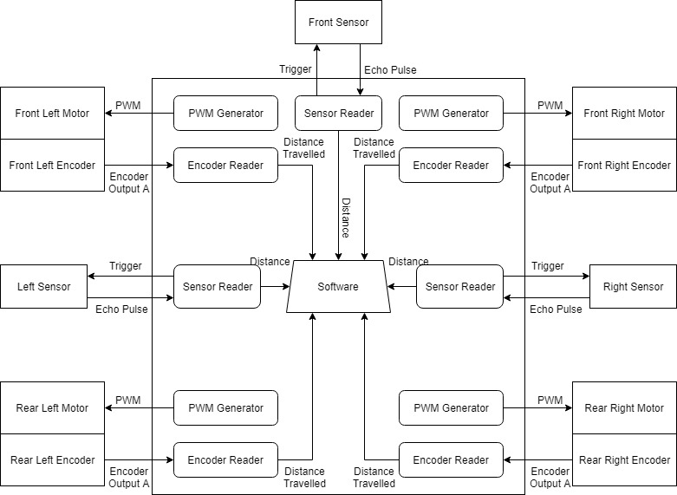
New Folder
High Level View
Notes:
Brandon

Slide 9
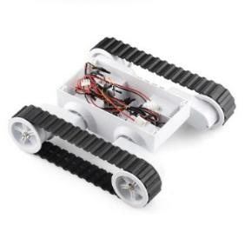
New Folder
High Level View
Zynq platform with custom PCB
Major Subsystems
Motors
PWM
Encoders
Sonic Sensors
Gyro\Accelerometer
LEDs
OpenCV Cameras
Systems are composed of several parts:
Physical Hardware
VHDL
C Drivers
Python Control Software ties it all together
AI Backend
Qt Frontend
Notes:
Brandon

Slide 10
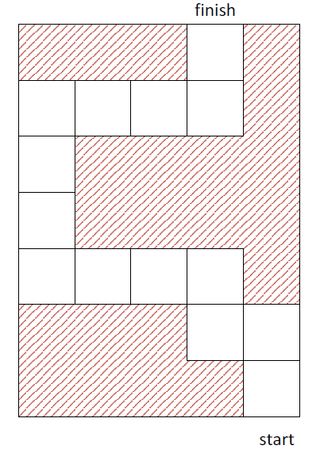

System Requirements
New Folder
Movement:
Rover should move in a straight line and in the middle of the path, and it should fix its course if otherwise.
Rover should not stop at any given time unless directly instructed.
Rover should maintain maximum speed during linear motion. It may slow down before a turn and speed up after a turn.
Rover should not hit a wall. (Optional fail-safe mechanism: Backward motion)
Rover should only turn after reaching half of the block
Notes:
Bach

Slide 11
System Requirements
New Folder
Control:
Rover should report its current position in the maze and draw the map as it travels via a GUI.
Rover should also report the data it’s reading via the GUI: speed, direction, sensors, IMU, etc.
Optional master controller module: Let user take total control over the rover (manual mode).
Timing-sensitive operations need to be implemented in VHDL. Resource-consuming algorithm should be avoided.
Notes:
Bach

Slide 12
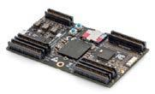
New Folder
Hardware
Snickerdoodle
Rover 5
Gyro Sensor/IMU - MPU-9250
Ultrasonic Sensors - HC-SR04
Camera Module - OV5642
DC Motor Driver - DRV8871
Notes:
Bach

Slide 13
Subsystems - PWM
New Folder
Requirements:
Have period and duty cycle inputs.
Be able to change output signal according to the inputs in real time.
Have an enable input to control the operation of all PWM modules.

Slide 14
Subsystem – Motors – PWM – C
New Folder
Registers
Four duty cycle registers, one direction register, one enable register
Two underlying configuration functions
void set_dir(uint64 address, bool forwards)
void set_duty(uint64 address, uint32 duty)
Eight ease-of-use functions, two for each PWM generator
Four “set_duty” functions
Four “set_dir” functions
Two synchronization functions
void set_enable(bool)
Turns all four PWM signals on and off at once
void reassert_enable()
Causes the PWM generators to simultaneously ingest duty cycles without stopping

Slide 15
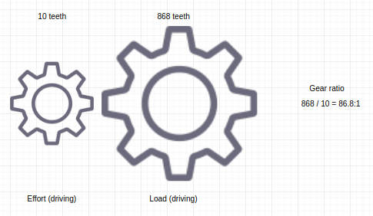
Subsystems – Encoders
New Folder
Requirements:
Update the number of state changes into registers every fixed amount of time (fixed Δt method).
Calculate velocity of the Rover.
Optional: Determine the direction and change of direction.

Slide 16
Subsystem – Encoders – C
New Folder
Four clearable encoder registers
uint32 read_encoder(uint64 address)
Four ease-of-use functions, one for each encoder
read_encoder_A, _B, _C, _D
Each calls the underlying read_encoder function with the correct address
void clear_encoders()
Clears all registers

Slide 17
Subsystems – Ultrasonic Sensors
New Folder
Requirements:
Have two modes of operation: Trigger Mode and Continuous Mode.
Trigger Mode: Only measure distance when instructed by CPU.
Continuous Mode: Measure distance every fixed amount of time.
Implement a timeout which indicates no obstacle.
Store the result in a register.

Slide 18
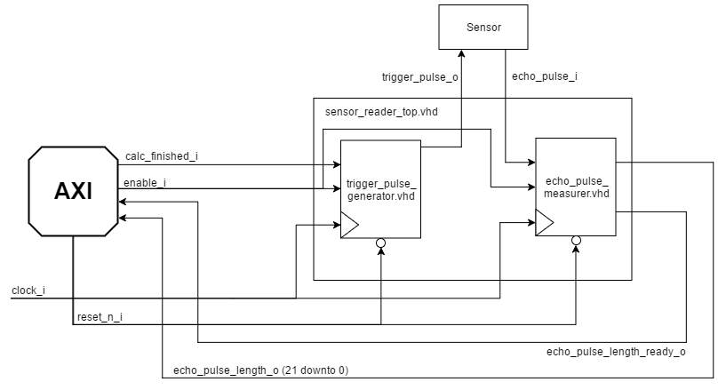
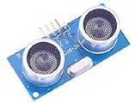
Subsystems – Ultrasonic Sensors
New Folder

Slide 19
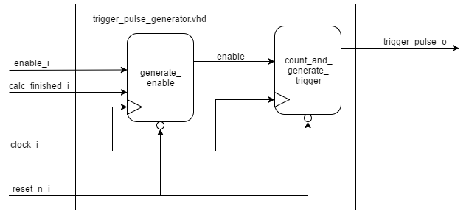
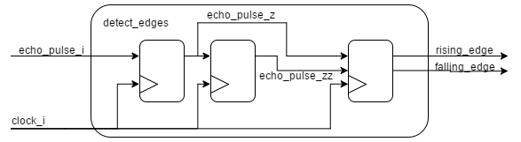
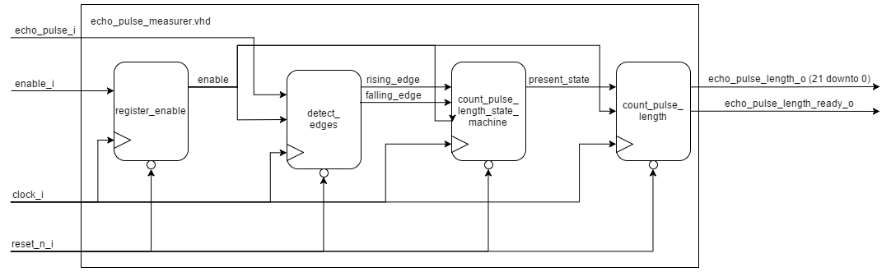
Subsystems – Ultrasonic Sensors (cont.)
New Folder

Slide 20
Subsystem – Sonic Sensors – C
New Folder
Each of the three sonic sensors has:
A read register that can be polled
An interrupt configuration register
An interrupt threshold register
uint32 read_sonic(uint64 addr)
Called in three different ease-of-use functions
void set_interrupt(bool enable)
Configures interrupt and registers handler
void clear_interrupt_flag(uint64 addr)

Slide 21
Subsystems – IMU
New Folder
Requirements:
Communicate via I2C interface.
Determine velocity (both linear and angular) and acceleration of the Rover.

Slide 22
Subsystem – Gyro IMU – C
New Folder
Uses I2C instead of AXI registers
void configure_mpu9250()
Sets the configuration registers for the IMU’s gyro and accelerometer
uint16 read_gyro_x(), read_gyro_y(), read_gyro_z()
uint16 read_accel_x(), _y(), _z()
bool self_test()
Runs the MPU-9250’s self-test diagnostic and returns a pass or failure result
Further research: using the built-in digital motion processing feature

Slide 23
Subsystems – LEDs
New Folder
LED 1 ON = Power On
Power On Successful = LED 1 {.5s} LED 2 {.5s} LED 3 {.5s} LED 2 & 3
LED 2 ON = In Motion
Power Off = LED 1, LED 2, LED 3 {.5s} LED 3 {.5s} LED 2 {.5s} LED 1
LED 3 ON = Obstacle in front
Calibrating = LED 1, LED 2, LED 3
LED 1 Blink = Power On Fault
LED 2 Blink = PWM Fault
LED 3 Blink = Ultrasonic Sensor Fault
LED 2 Blink & LED 3 Blink = Gyro Sensor Fault

Slide 24
Subsystem – LEDs – C
New Folder
Three LEDs
Each has a register with three fields:
Enable flag
Blink flag
Blink period (uint16)
void enable_LED_A(), enable_LED_B(), enable_LED_C()
void set_blink_A(uint16 period), set_blink_B(uint16 period), set_blink_C(uint16 period)
void enable_blink_A(), enable_blink_B(), enable_blink_C()

Slide 25
Python On-Board/Remote GUI
New Folder
Requirements:
Allow users to RDP into board to see GUI.
GUI will display various measurements, readings and video feed.
Calibration can be accessed from here.
Implement web-server/page for remote access via ip address (Flask, Django).

Slide 26
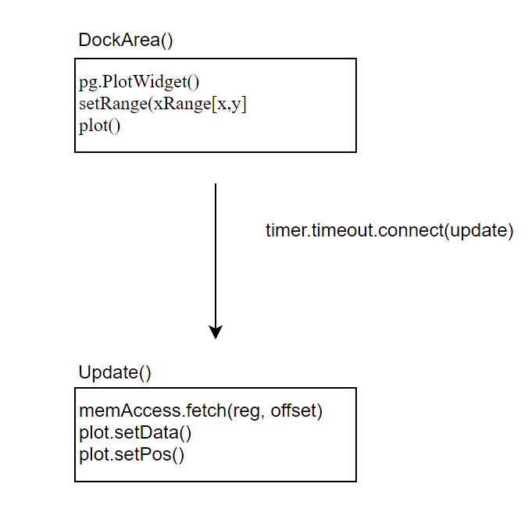
Subsystems – GUI
New Folder
Import - QtCore, QtQui, and PyQtGraph

Slide 27
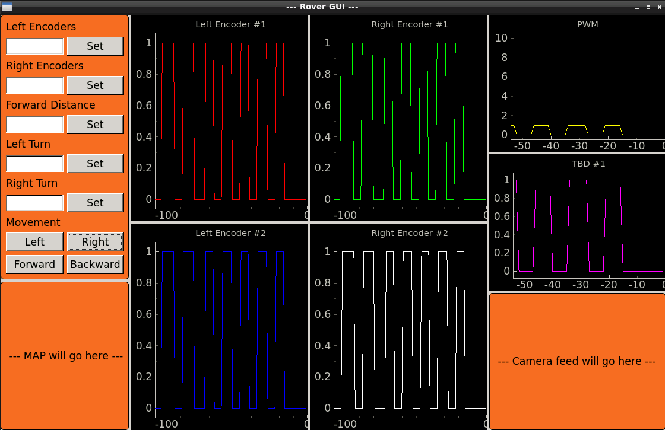
Subsystems – GUI
New Folder

Slide 28
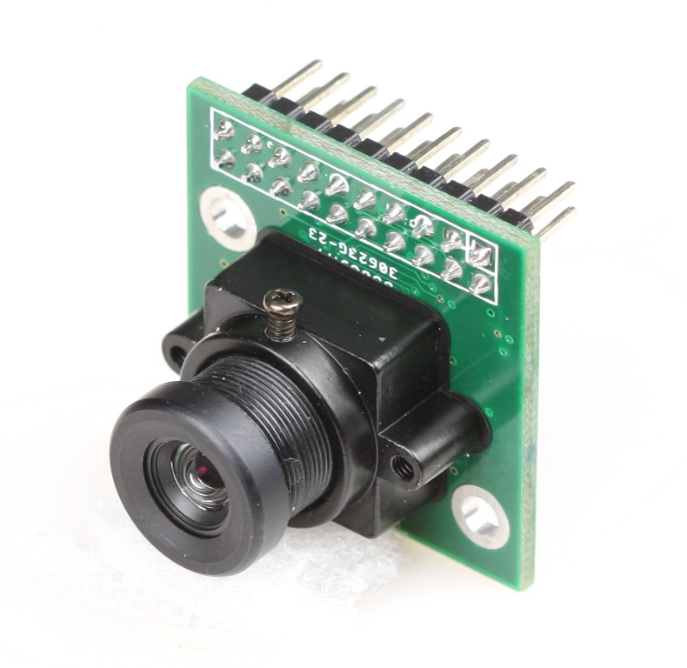
Subsystems – OpenCV
New Folder
Requirements:
Use of optics to allow “vision” for Rover.
Thresholding, filtering, gradient application – tools to help object isolation in an image or video feed.
Become a redundancy system to detect the wall.

Slide 29
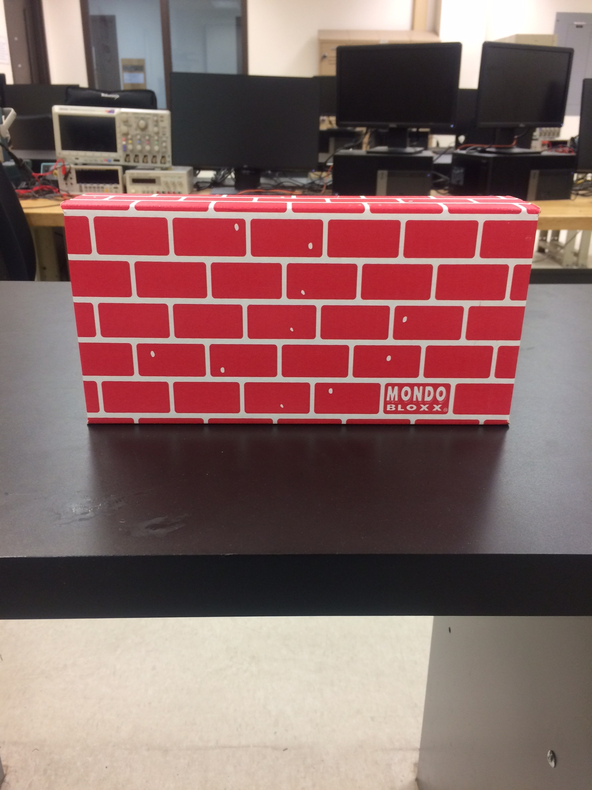
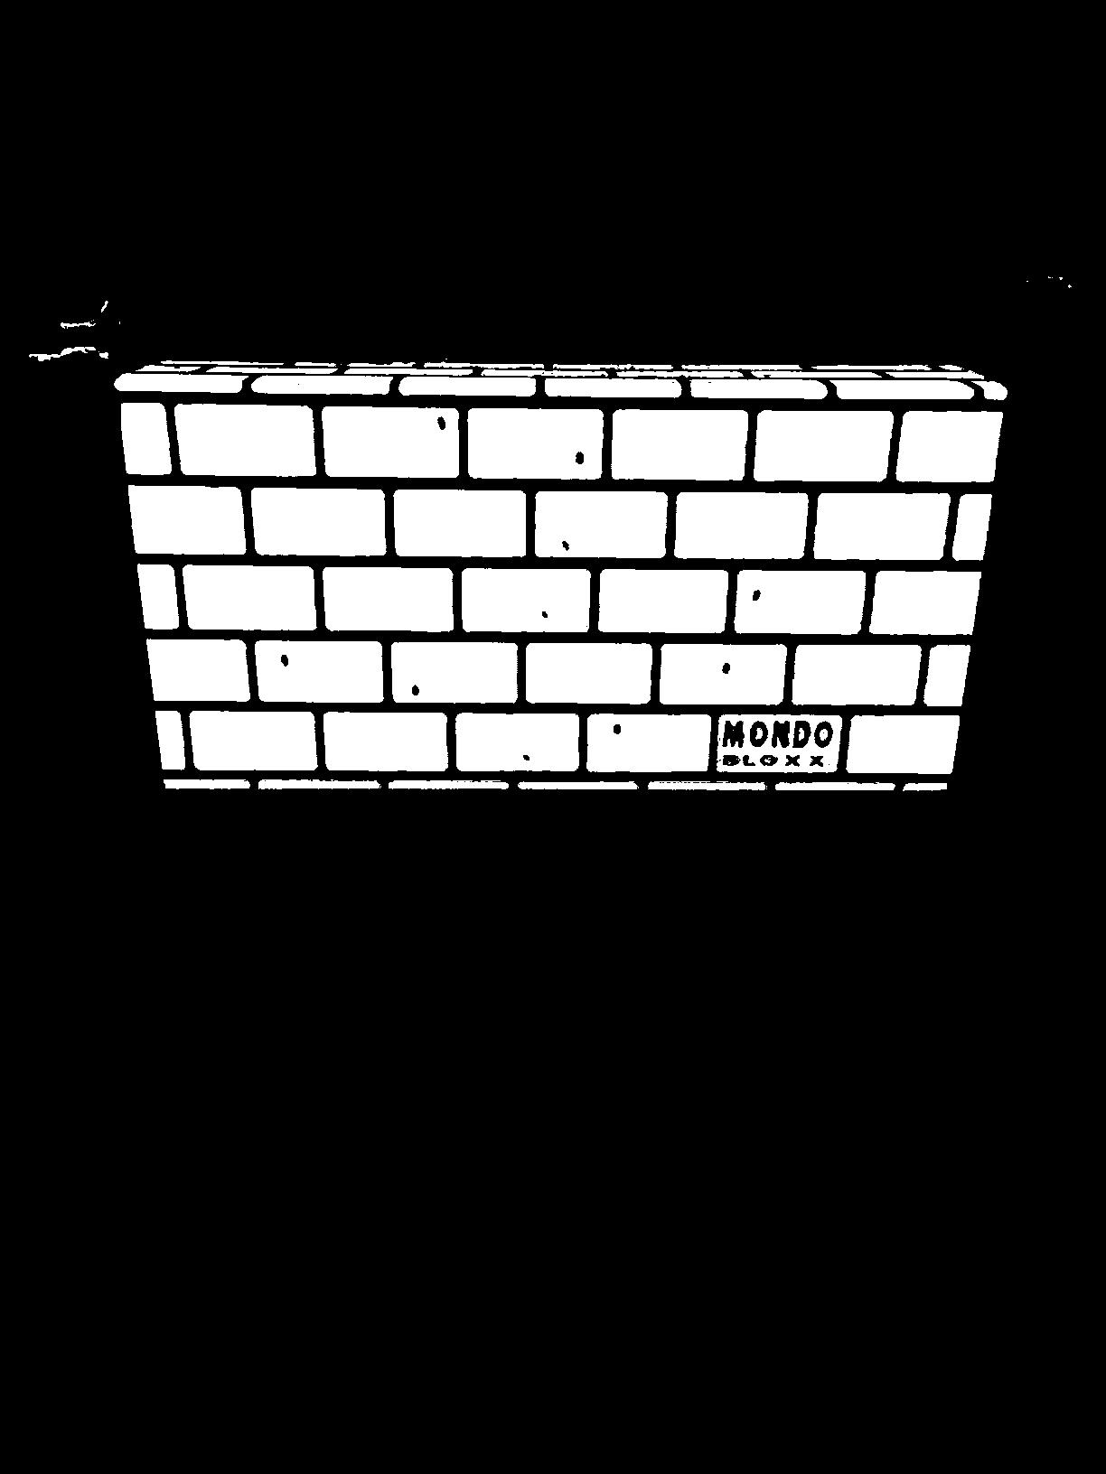
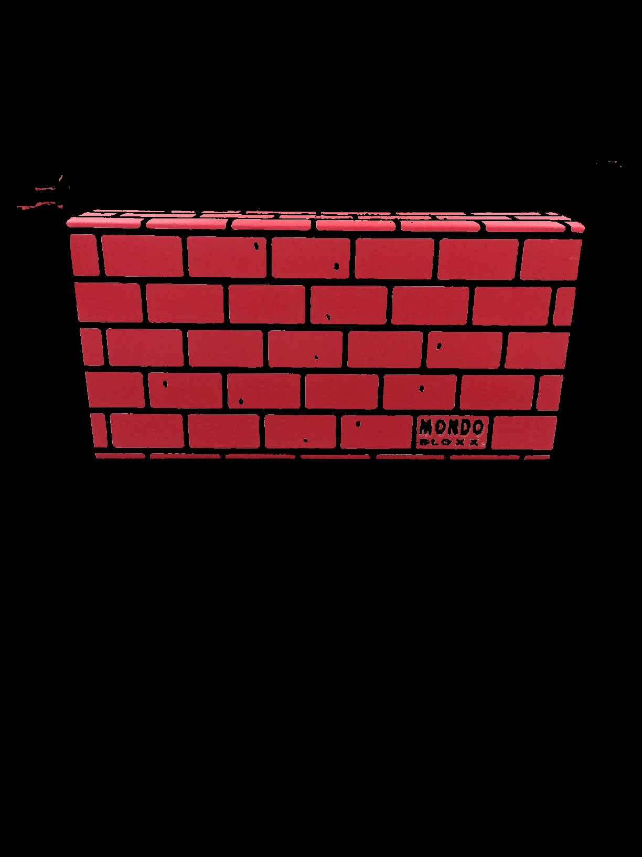
OpenCV examples
New Folder
Original
Mask
Result

Slide 30
OpenCV - Haar Cascades
New Folder
XML files that are generated used in custom object detection
Different but can be used on top of/in conjunction with filtering and previously mentioned techniques

Slide 31
OpenCV - How to create a Haar Cascade
New Folder
Many positive images* (images that contain the desired object)
Many negative images (images that do not contain the object)
Description files for both positive and negative image sets (Txt file that includes all paths to negative and positive images and for positive images the object’s coordinates in the image and count)
Positive vector files (file that contains metadata for all positive images)
* At least one so we can create samples

Slide 32
OpenCV - How to create a Haar Cascade
New Folder
Collecting thousands of positive and negative images can be cumbersome
Can use a copied set of the negative images as positive images by creating samples via “opencv_createsamples” command
Transforms negative images to include object in image with varying depth, angle and orientation.

Slide 33
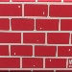
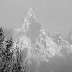
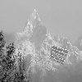
OpenCV - How to create a Haar Cascade
New Folder
Initial positive image
Negative image
Created sample (positive image)

Slide 34
OpenCV - How to create a Haar Cascade
New Folder
After positive samples are generated and vector file created you can begin training
Very lengthy process depending on number of positive/negative images used, *dimensions of images trained on and number of stages to complete (accuracy vs. time)
Carried out via “opencv_traincascade” command
*Training on a 20x20px across ~2000 images for 10 stages took around 4 hours

Slide 35
OpenCV - How to create a Haar Cascade
New Folder
After completion you will be left with the cascade in .xml format which can be implemented in your program as a CascadeClassifier

Slide 36
OpenCV - Haar Cascade Results
New Folder

Slide 37
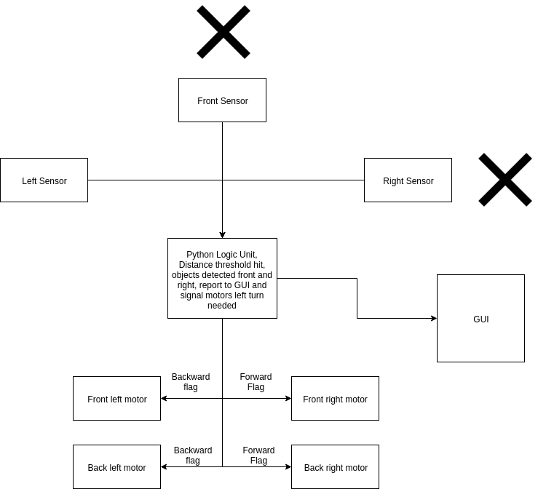
Rudimentary Python Implementation
New Folder

Slide 38
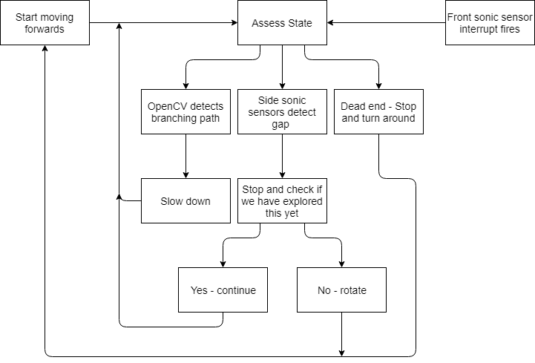
Rudimentary Python Algorithm
New Folder

Slide 39
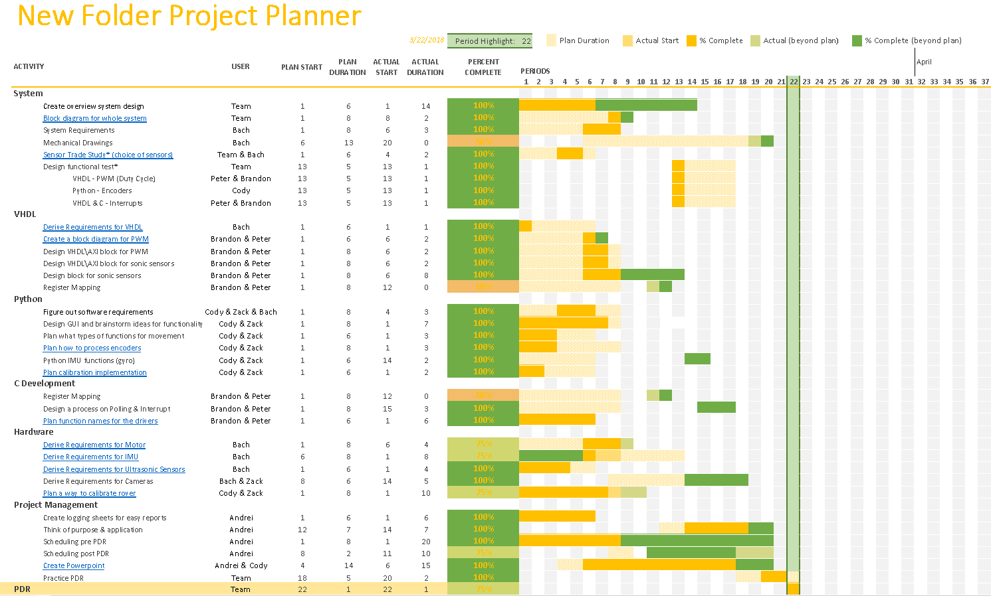
Schedule – Pre PDR
New Folder
Gantt Chart
Notes:
Andrei

Slide 40
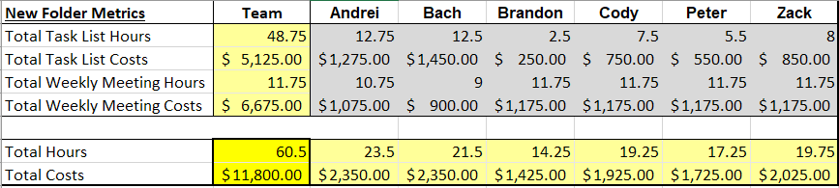
Expenses
New Folder
Notes:
Cody

Slide 41
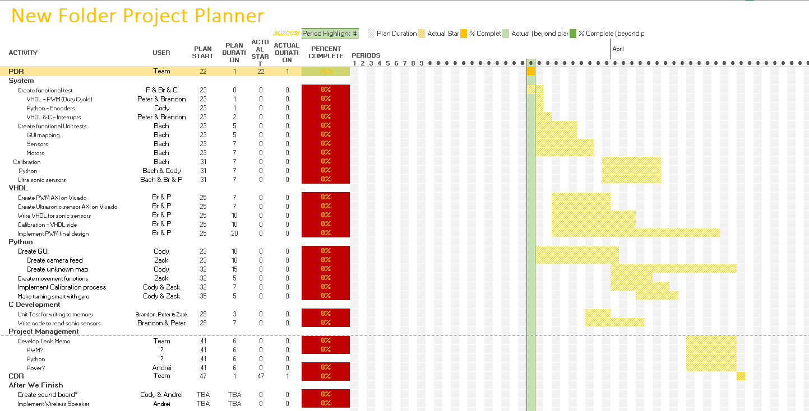
Schedule – Post PDR
New Folder
Gantt Chart
Notes:
Andrei

Slide 42
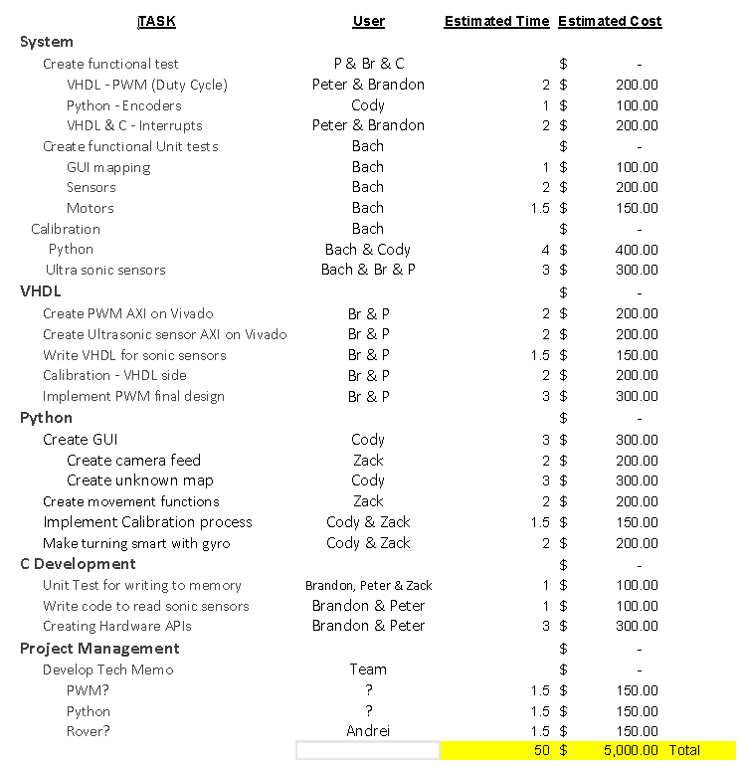
Future Costs
New Folder
Future Costs
+ 15 Weekly Meeting Hours
Final Hours | Final Costs
65 Hrs | $6,500.00
Notes:
Cody

Slide 43
Risks
New Folder
Hitting a wall and getting stuck.
Counter: Backward motion, or Manual mode.
Connection issues between Rover and PC.
Counter: Prepare backup Snickerdoodle(s).
Component failures.
Counter: Deploy unit testing and LED fault indicators.
System failure.
Counter: Deploy integration testing and LED fault indicators.
Notes:
Bach

Slide 44
Test Plan Overview
New Folder
PWM: Through testbench in ModelSim.
Encoders: Rotate the wheels manually then measure the speed and compare with the calculated value from the encoders.
Ultrasonic Sensors: Test both Trigger Mode and Continuous Mode with several predetermined distances. LEDs will light if within distance of object.
IMU: Same as encoders.
LEDs: Used for integration testing.
GUI: Should update data every fixed amount of time while operational.
OpenCV: Need to detect the wall and indicate on-screen as well as by a flag.

Slide 45
Future Roadmap
New Folder
Prototype
Implementation
Functional Tests
Calibration
Tech Memos
Phase II
Web development
Rugged Design
Arm Attachment
Thermal Sensors
Air Pollution Sensors
Mic and Speakers
Color changing LEDs

